Slide 1


Electric Circuits
Twelfth Edition, Global Edition
Chapter 4 – Part 4
Techniques of Circuit Analysis
© 2024 Pearson Education Ltd. All Rights Reserved.
Notes:
If this PowerPoint presentation contains mathematical equations, you may need to check that your computer has the following installed:
1) Math Type Plugin
2) Math Player (free versions available)
3) NVDA Reader (free versions available)

Slide 2
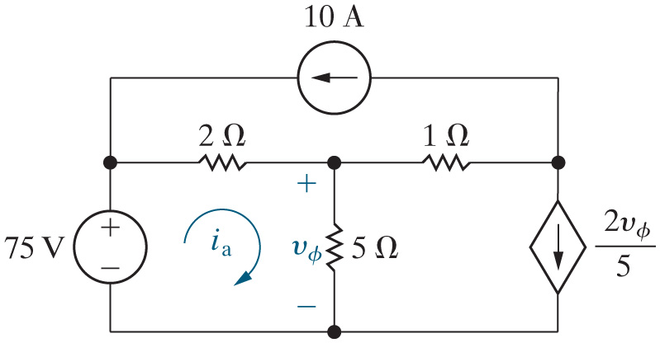
Chapter 4 – techniques of circuit analysis (1 of 12)
What is the value of the mesh current in the upper mesh?
A. 10 A
B. −10 A
C. 75 V / 2 + 3
D. We cannot tell until we analyze the circuit!

Slide 3


Chapter 4 – techniques of circuit analysis (1 of 12)
What is the value of the mesh current in the upper mesh?
A. 10 A
B. −10 A
C. 75 V / 2 + 3
D. We cannot tell until we analyze the circuit!

Slide 4
Chapter 4 – techniques of circuit analysis (2 of 12)
Modify the mesh current analysis method to handle circuits with a current source in a single mesh:
Step 1 – Identify the meshes with curved directed arrows that follow the perimeter of each mesh.
Step 2 – Label the mesh currents for each mesh.
  If a current source is in a single mesh, label the mesh current with the value of the current source.
Step 3 – Write a K V L equation for each mesh where the current is unknown.
  If there are dependent sources, write a dependent source constraint equation for each.
Step 4 – Solve the K V L equations to find the mesh current values.
Step 5 – Solve the circuit using mesh currents from Step 4 to find component currents, voltages, and power values.
A current source in a single mesh is the dual of a voltage source between two nonreference essential nodes.

Slide 5
Chapter 4 – techniques of circuit analysis (3 of 12)
If we use the revised analysis method to label the mesh currents, how many K V L equations will we have to write?
A. 3
B. 2
C. 1
D. 0

Slide 6
Chapter 4 – techniques of circuit analysis (3 of 12)
If we use the revised analysis method to label the mesh currents, how many K V L equations will we have to write?
A. 3
B. 2
C. 1
D. 0

Slide 7

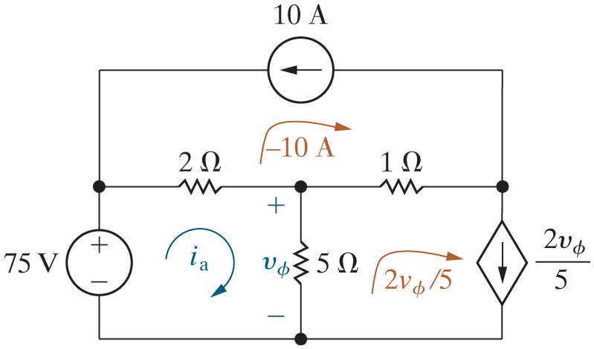
Chapter 4 – techniques of circuit analysis (4 of 12)
Find
using the mesh current method.
After Steps 1 and 2:

Slide 8
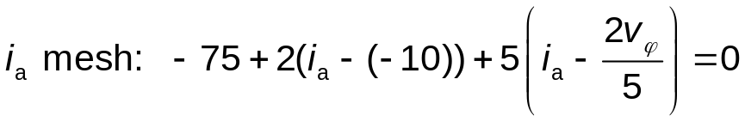
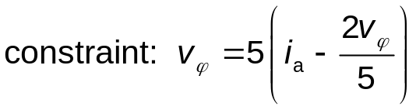
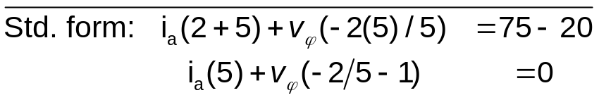

Chapter 4 – techniques of circuit analysis (5 of 12)
Find
using the mesh current method.
Write the K V L equations and dependent source constraint equations (Step 3) and solve them (Step 4):
Notes:
Long Description 1:
i subscript a Base Line mesh: negative 75 plus 2 Open Parenthesis i subscript a Base Line minus Open Parenthesis negative 10 Close Parenthesis Close Parenthesis plus 5 Open Parenthesis i subscript a Base Line minus Start Fraction 2 v subscript Phi Base Line over 5 End Fraction Close Parenthesis equals 0.
Long Description 2:
Std. form: i subscript a Base Line Open Parenthesis 2 plus 5 Close Parenthesis plus v subscript Phi Base Line Open Parenthesis negative 2 Open Parenthesis 5 Close Parenthesis divided by 5 Close Parenthesis equals 75 minus 20.
i subscript a Base Line Open Parenthesis 5 Close Parenthesis plus v subscript Phi Base Line Open Parenthesis negative 2 divided by 5 minus 1 Close Parenthesis equals 0.

Slide 9
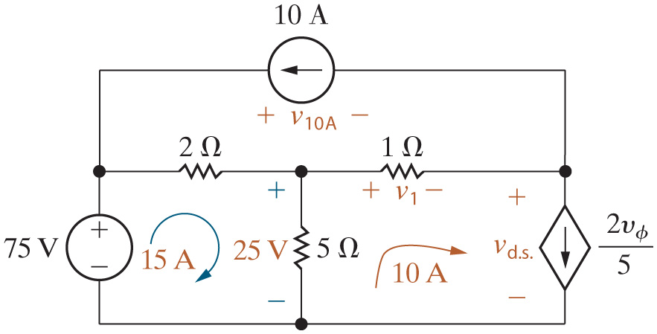









Chapter 4 – techniques of circuit analysis (6 of 12)
Power balance:
Component | Equation | p [W]
75 V | −(15)(75) | −1125
Dep. source | (5)(10) | 50
10 A | −(70)(10) | −700
2 Ohms. | Open Parenthesis 15 plus 10 Close Parenthesis squared multiplied by Open Parenthesis 2 CloseParenthesis. | 1250
1 Ohm. | Open Parenthesis 10 plus 10 Close Parenthesis squared multiplied by Open Parenthesis 1 CloseParenthesis. | 400
5 Ohms. | 25 squared divided by 5. | 125

Slide 10
Chapter 4 – techniques of circuit analysis (7 of 12)
The node voltage method has a “special case” when a circuit has a supernode – a voltage source that is the only component in a branch connecting two nonreference essential nodes. The mesh current method has a special case for “super meshes”, which exist when
A voltage source is in a single mesh.
A current source is in a single mesh.
A voltage source is shared between two meshes.
A current source is shared between two meshes.

Slide 11
Chapter 4 – techniques of circuit analysis (7 of 12)
The node voltage method has a “special case” when a circuit has a supernode – a voltage source that is the only component in a branch connecting two nonreference essential nodes. The mesh current method has a special case for “super meshes”, which exist when
A voltage source is in a single mesh.
A current source is in a single mesh.
A voltage source is shared between two meshes.
A current source is shared between two meshes.

Slide 12
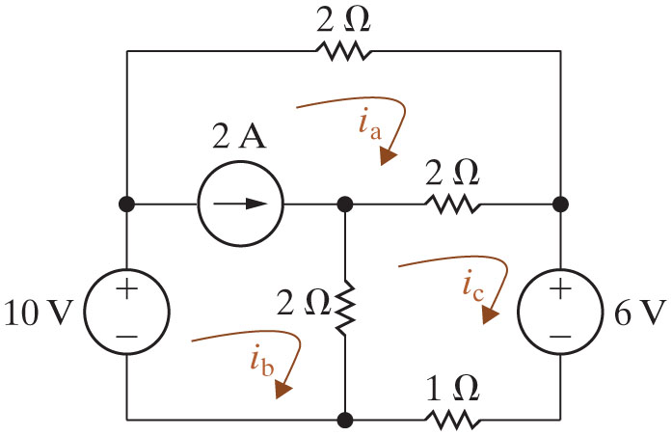



Chapter 4 – techniques of circuit analysis (8 of 12)
This circuit has a supermesh created from the two meshes with the following mesh currents:
A.
and
B.
and
C.
and
D.
and
and

Slide 13
Chapter 4 – techniques of circuit analysis (8 of 12)
This circuit has a supermesh created from the two meshes with the following mesh currents:
A.
and
B.
and
C.
and
D.
and
and

Slide 14
Chapter 4 – techniques of circuit analysis (9 of 12)
The final version of the mesh current analysis method, which handles all three special cases:
Step 1 – Identify the meshes with curved directed arrows that follow the perimeter of each mesh.
Step 2 – Label the mesh currents for each mesh.
If a current source is in a single mesh, label the mesh current with the value of the current source.
  If a current source is shared between two meshes, combine the meshes to create a supermesh and mentally erase the current source.
Step 3 – Write a K V L equation for each supermesh and for each single mesh where the current is unknown.
  If there are dependent sources, write a dependent source constraint equation for each.
  If there are supermeshes, write a supermesh constraint equation for each.
Step 4 – Solve the K V L equations to find the mesh current values.
Step 5 – Solve the circuit using mesh currents from Step 4 to find component currents, voltages, and power values.

Slide 15

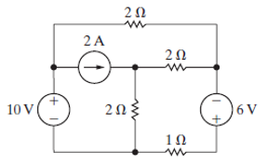
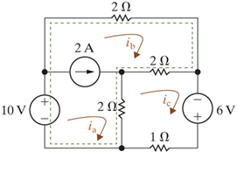
Chapter 4 – techniques of circuit analysis (10 of 12)
Find the power absorbed by the
resistor using the mesh
current method.
After Steps 1 and 2:

Slide 16
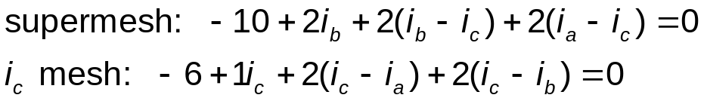
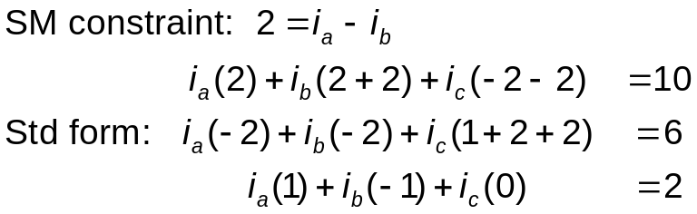
Chapter 4 – techniques of circuit analysis (11 of 12)
Writing the equations (Step 3) and solving them (Step 4).
Notes:
Long Description 1:
Supermesh: negative 10 plus 2 i subscript b Base Line plus 2 Open Parenthesis i subscript b Base Line minus i subscript c Base Line Close Parenthesis plus 2 Open Parenthesis i subscript a Base Line minus i subscript c Base Line Close Parenthesis equals 0.
i subscript c Base Line mesh: negative 6 plus 1 i subscript c Base Line plus 2 Open Parenthesis i subscript c Base Line minus i subscript a Base Line Close Parenthesis plus 2 Open Parenthesis i subscript c Base Line minus i subscript b Base Line Close Parenthesis equals 0.
Long Description 2:
S M constraint: It shows 2 lines. Line 1: 2 equals i subscript a Base Line minus i subscript b Base Line.
Line 2: i subscript a Base Line Open Parenthesis 2 Close Parenthesis plus i subscript b Base Line Open Parenthesis 2 plus 2 Close Parenthesis plus i subscript c Base Line Open Parenthesis negative 2 minus 2 Close Parenthesis equals 10.
Std form: It shows 2 lines. Line 1: i subscript a Base Line Open Parenthesis negative 2 Close Parenthesis plus i subscript b Base Line Open Parenthesis negative 2 Close Parenthesis plus i subscript c Open Parenthesis 1 plus 2 plus 2 Close Parenthesis equals 6.
Line 2: i subscript a Base Line Open Parenthesis 1 Close Parenthesis plus i subscript b Base Line Open Parenthesis negative 1 Close Parenthesis plus i subscript c Base Line Open Parenthesis 0 Close Parenthesis equals 2.

Slide 17

Copyright
This work is protected by United Kingdom copyright laws and is provided solely for the use of instructors in teaching their courses and assessing student learning. Dissemination or sale of any part of this work (including on the World Wide Web) will destroy the integrity of the work and is not permitted. The work and materials from it should never be made available to students except by instructors using the accompanying text in their classes. All recipients of this work are expected to abide by these restrictions and to honor the intended pedagogical purposes and the needs of other instructors who rely on these materials.

